Slide 1
PokeDex

Slide 2
PokeDex

Slide 3
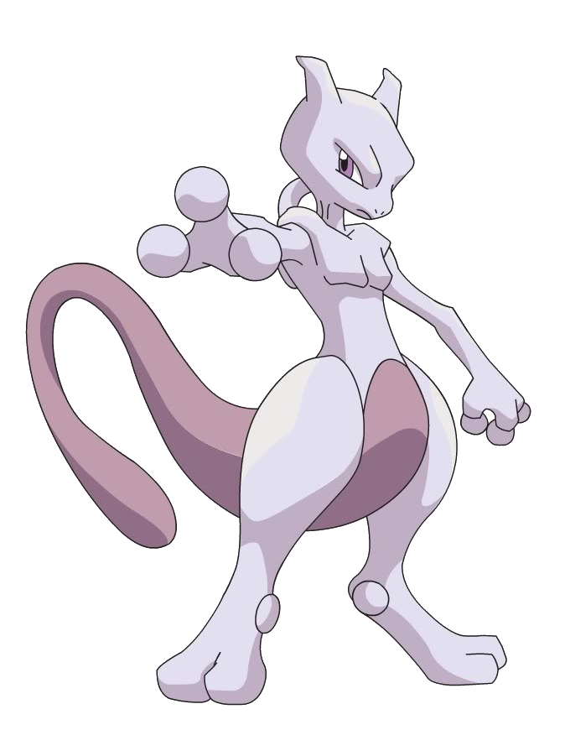
OUR TEAM
Software Engineer
Data Engineer
Obaedur Rahman
Rodrigo Proano
Software Engineer
Software Engineer
Kevin Sanchez
Luis DeJesus
Project Manager
Amir Mahmoud

Slide 4
What is Pokemon?

Slide 5
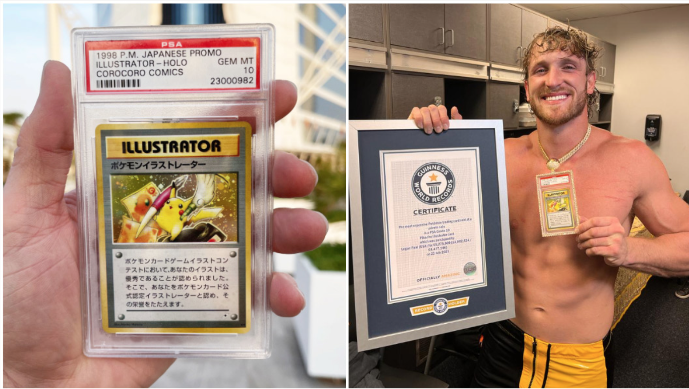
YouTuber Logan Paul coveted PSA Grade 10 Pikachu Illustrator card following a record-breaking trade worth $5,275,000.

Slide 6
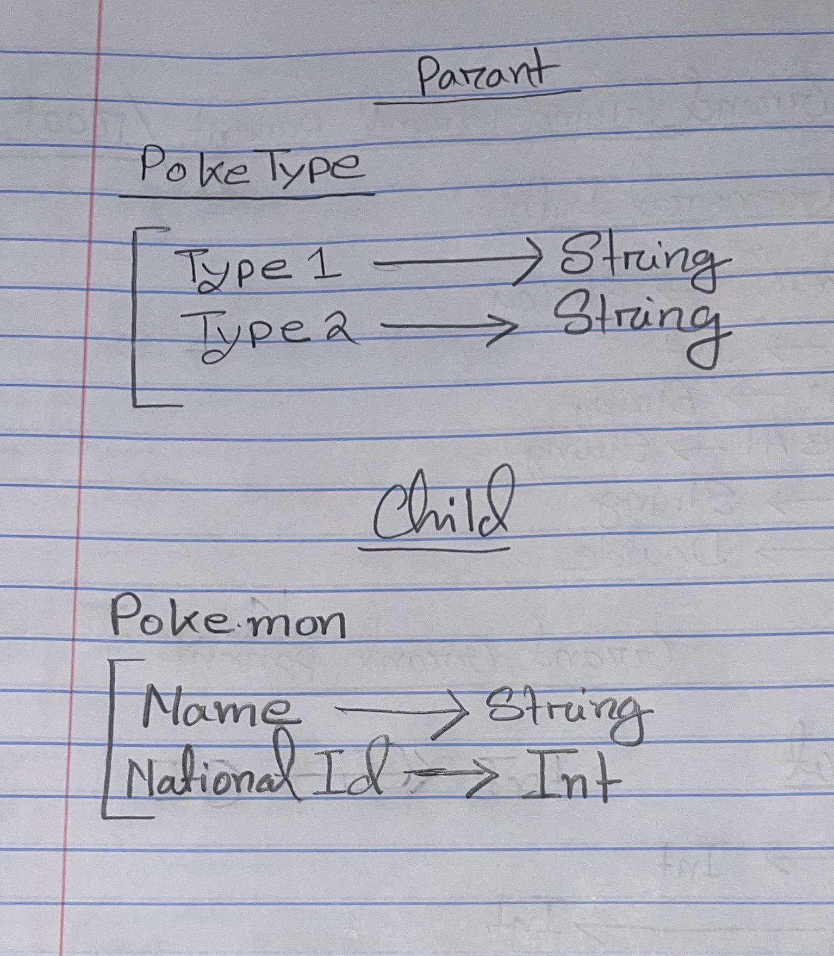
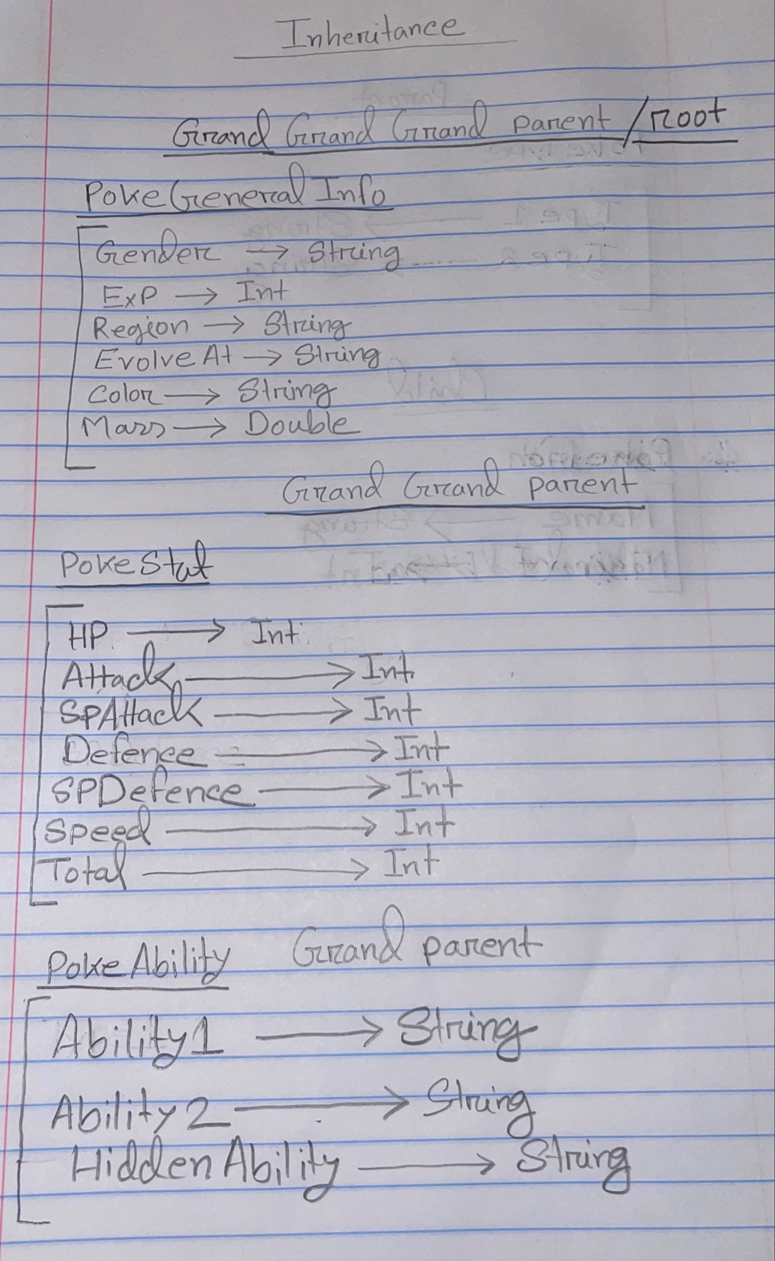
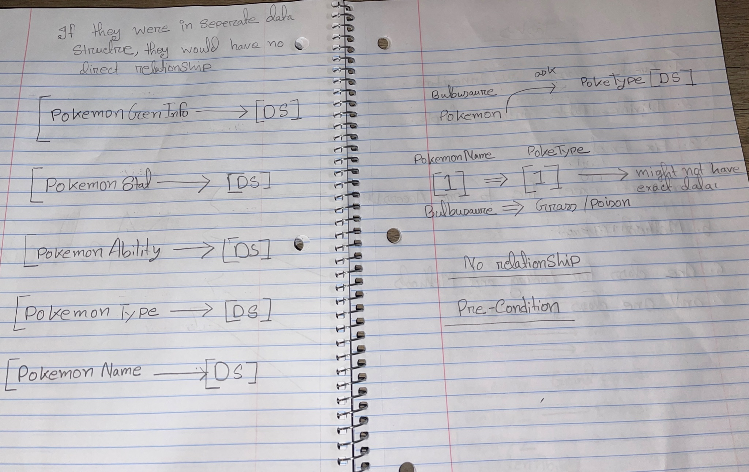
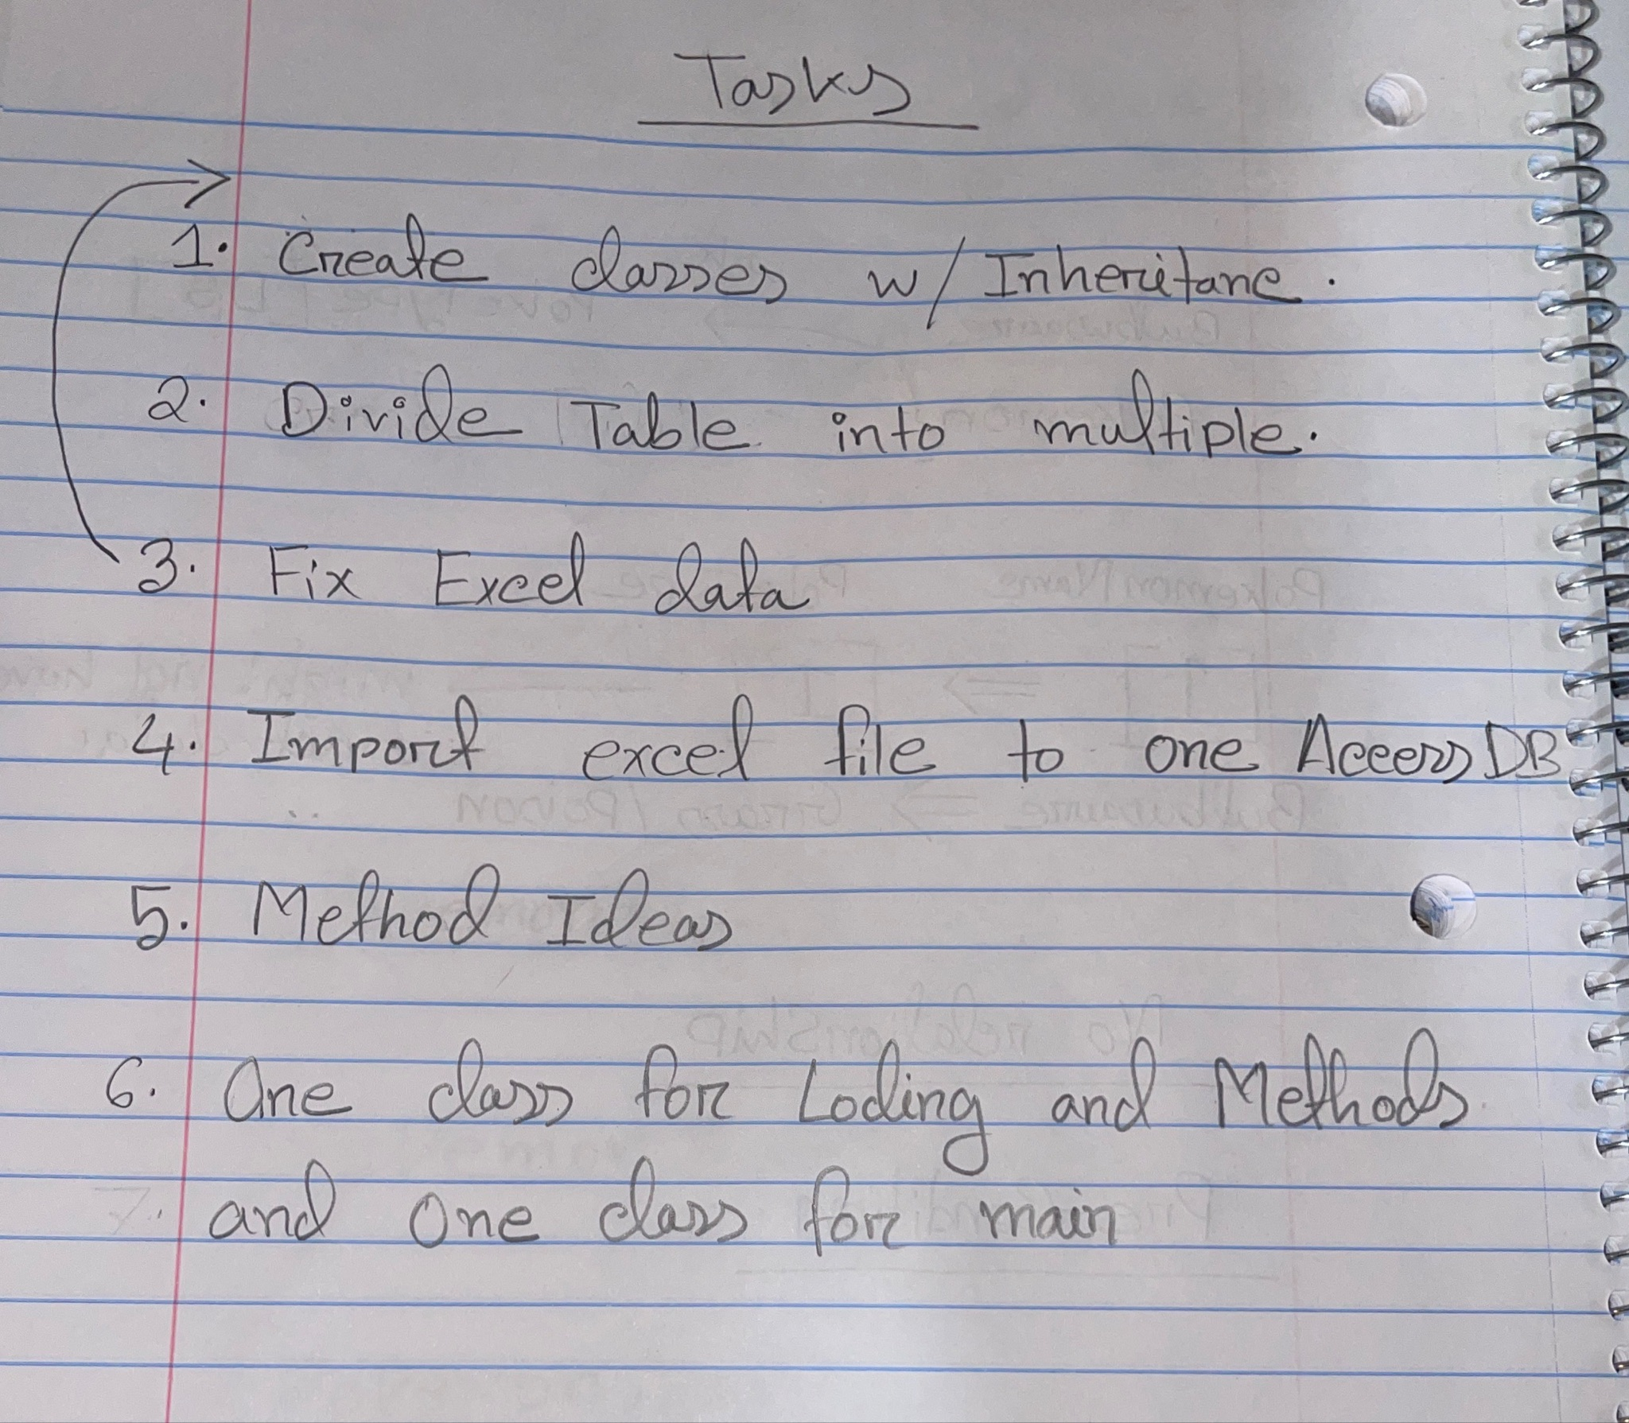
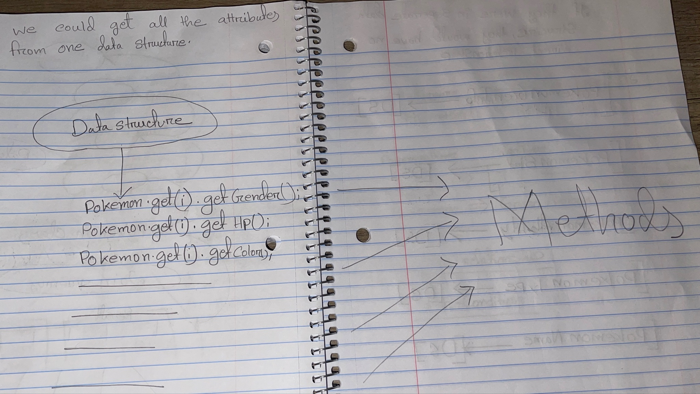
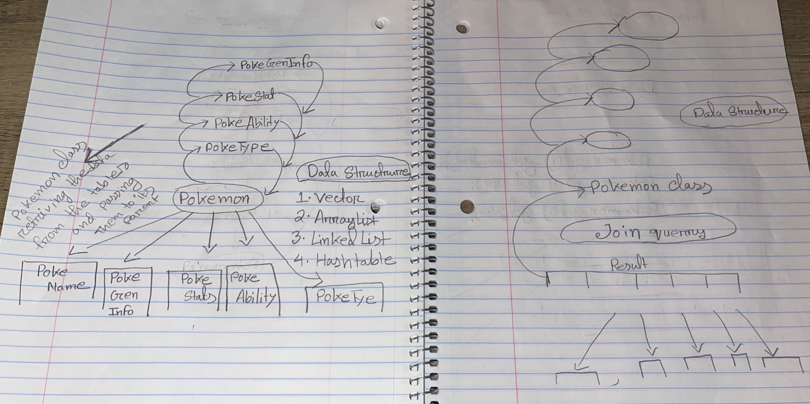
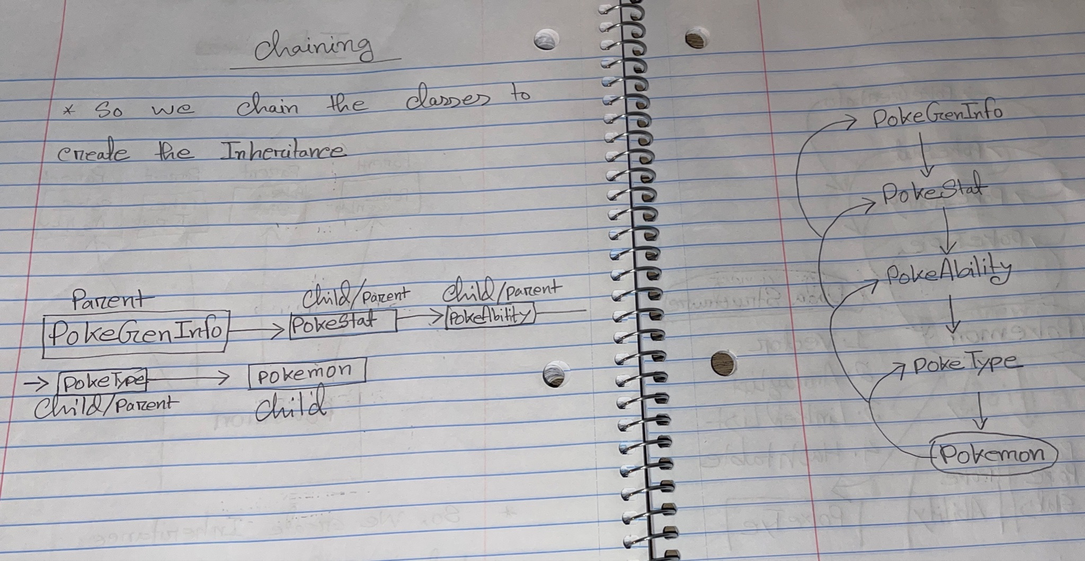
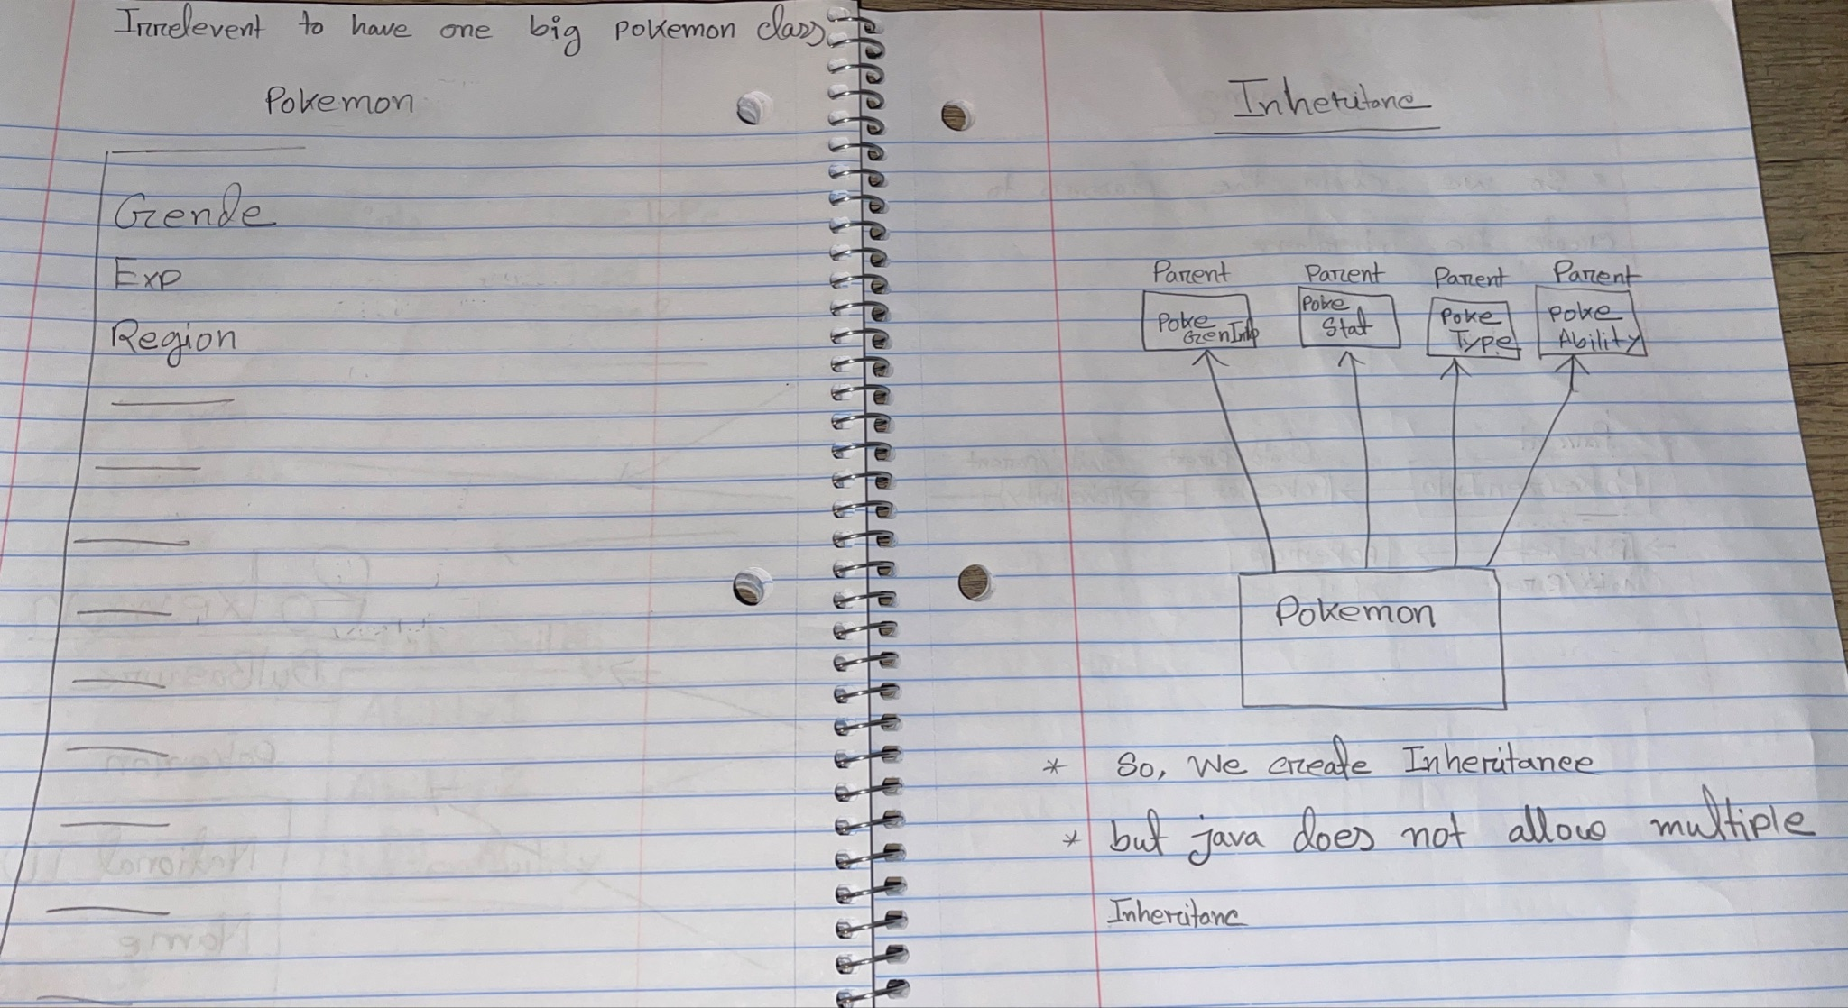
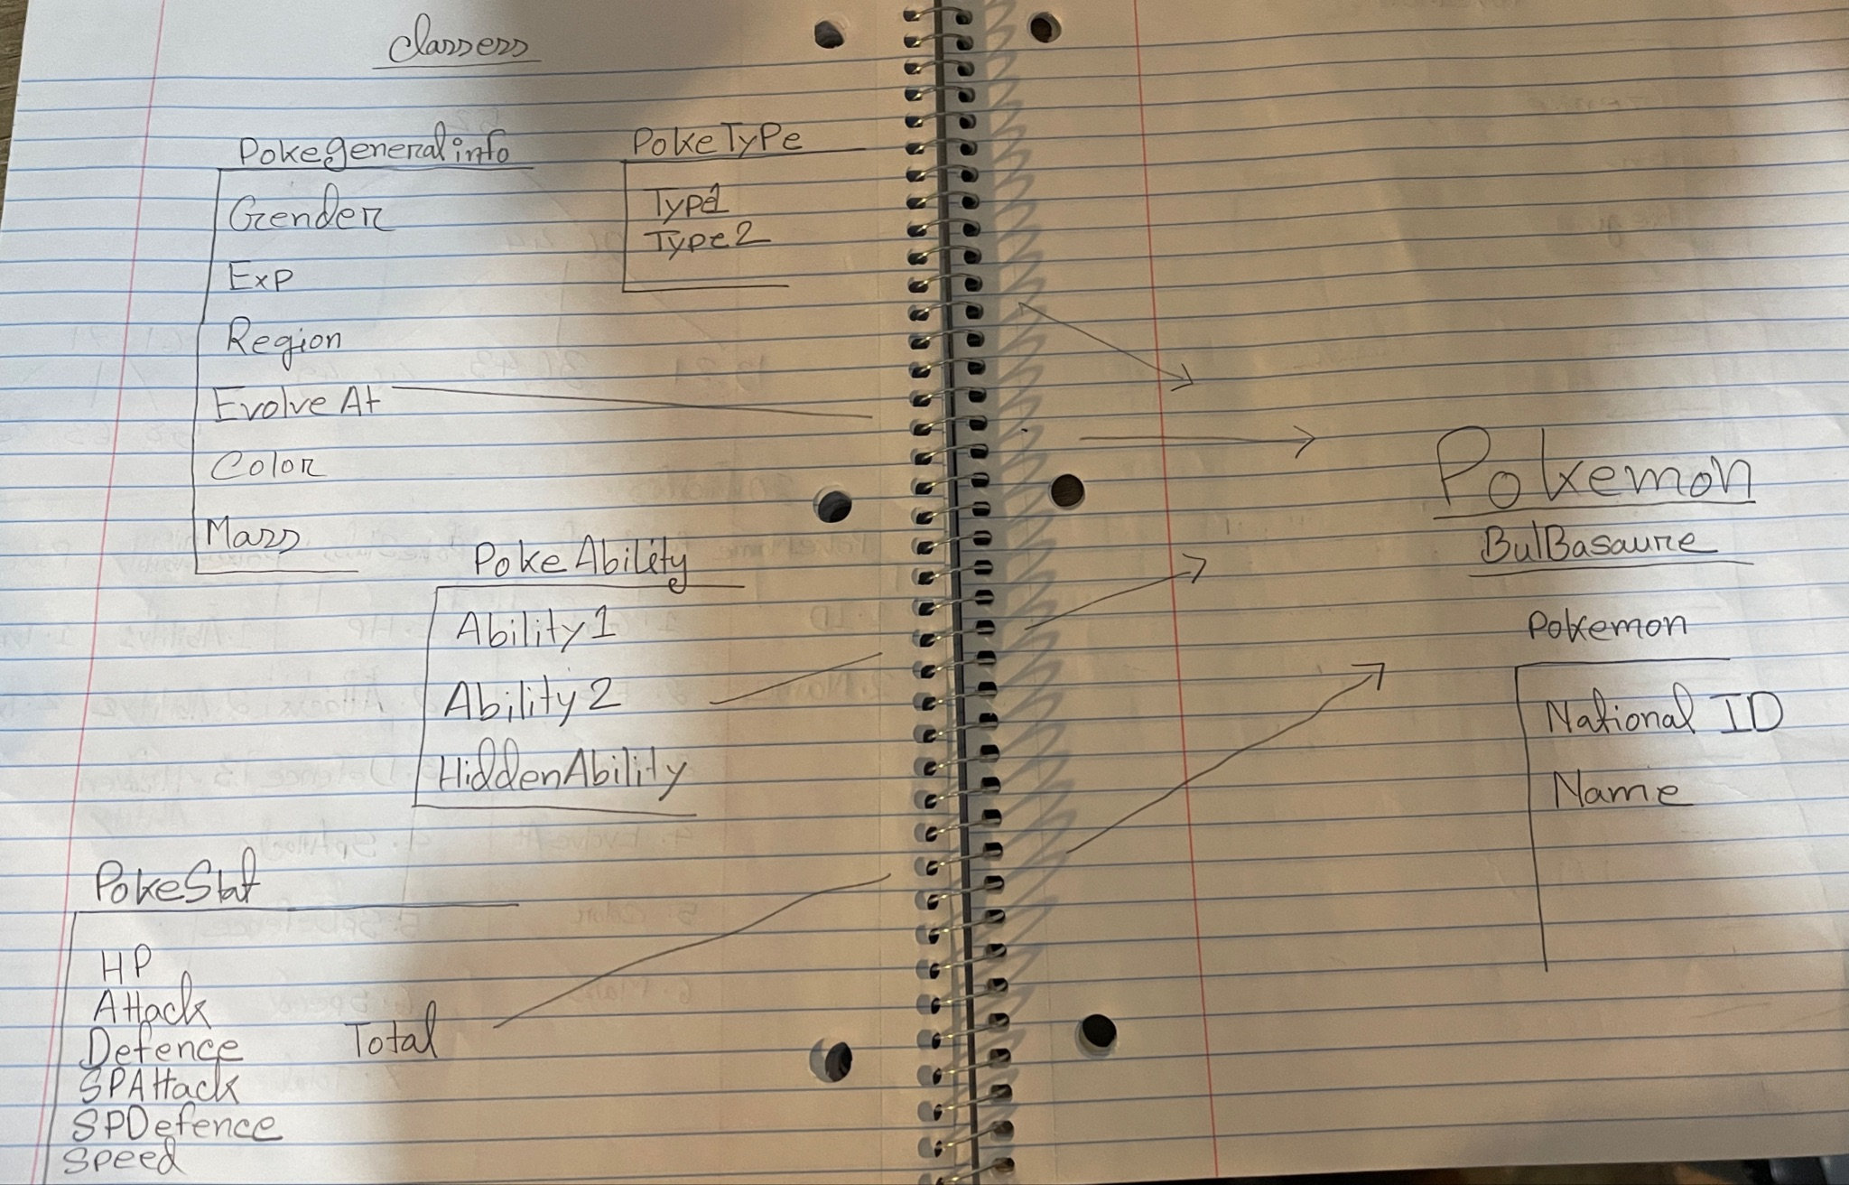
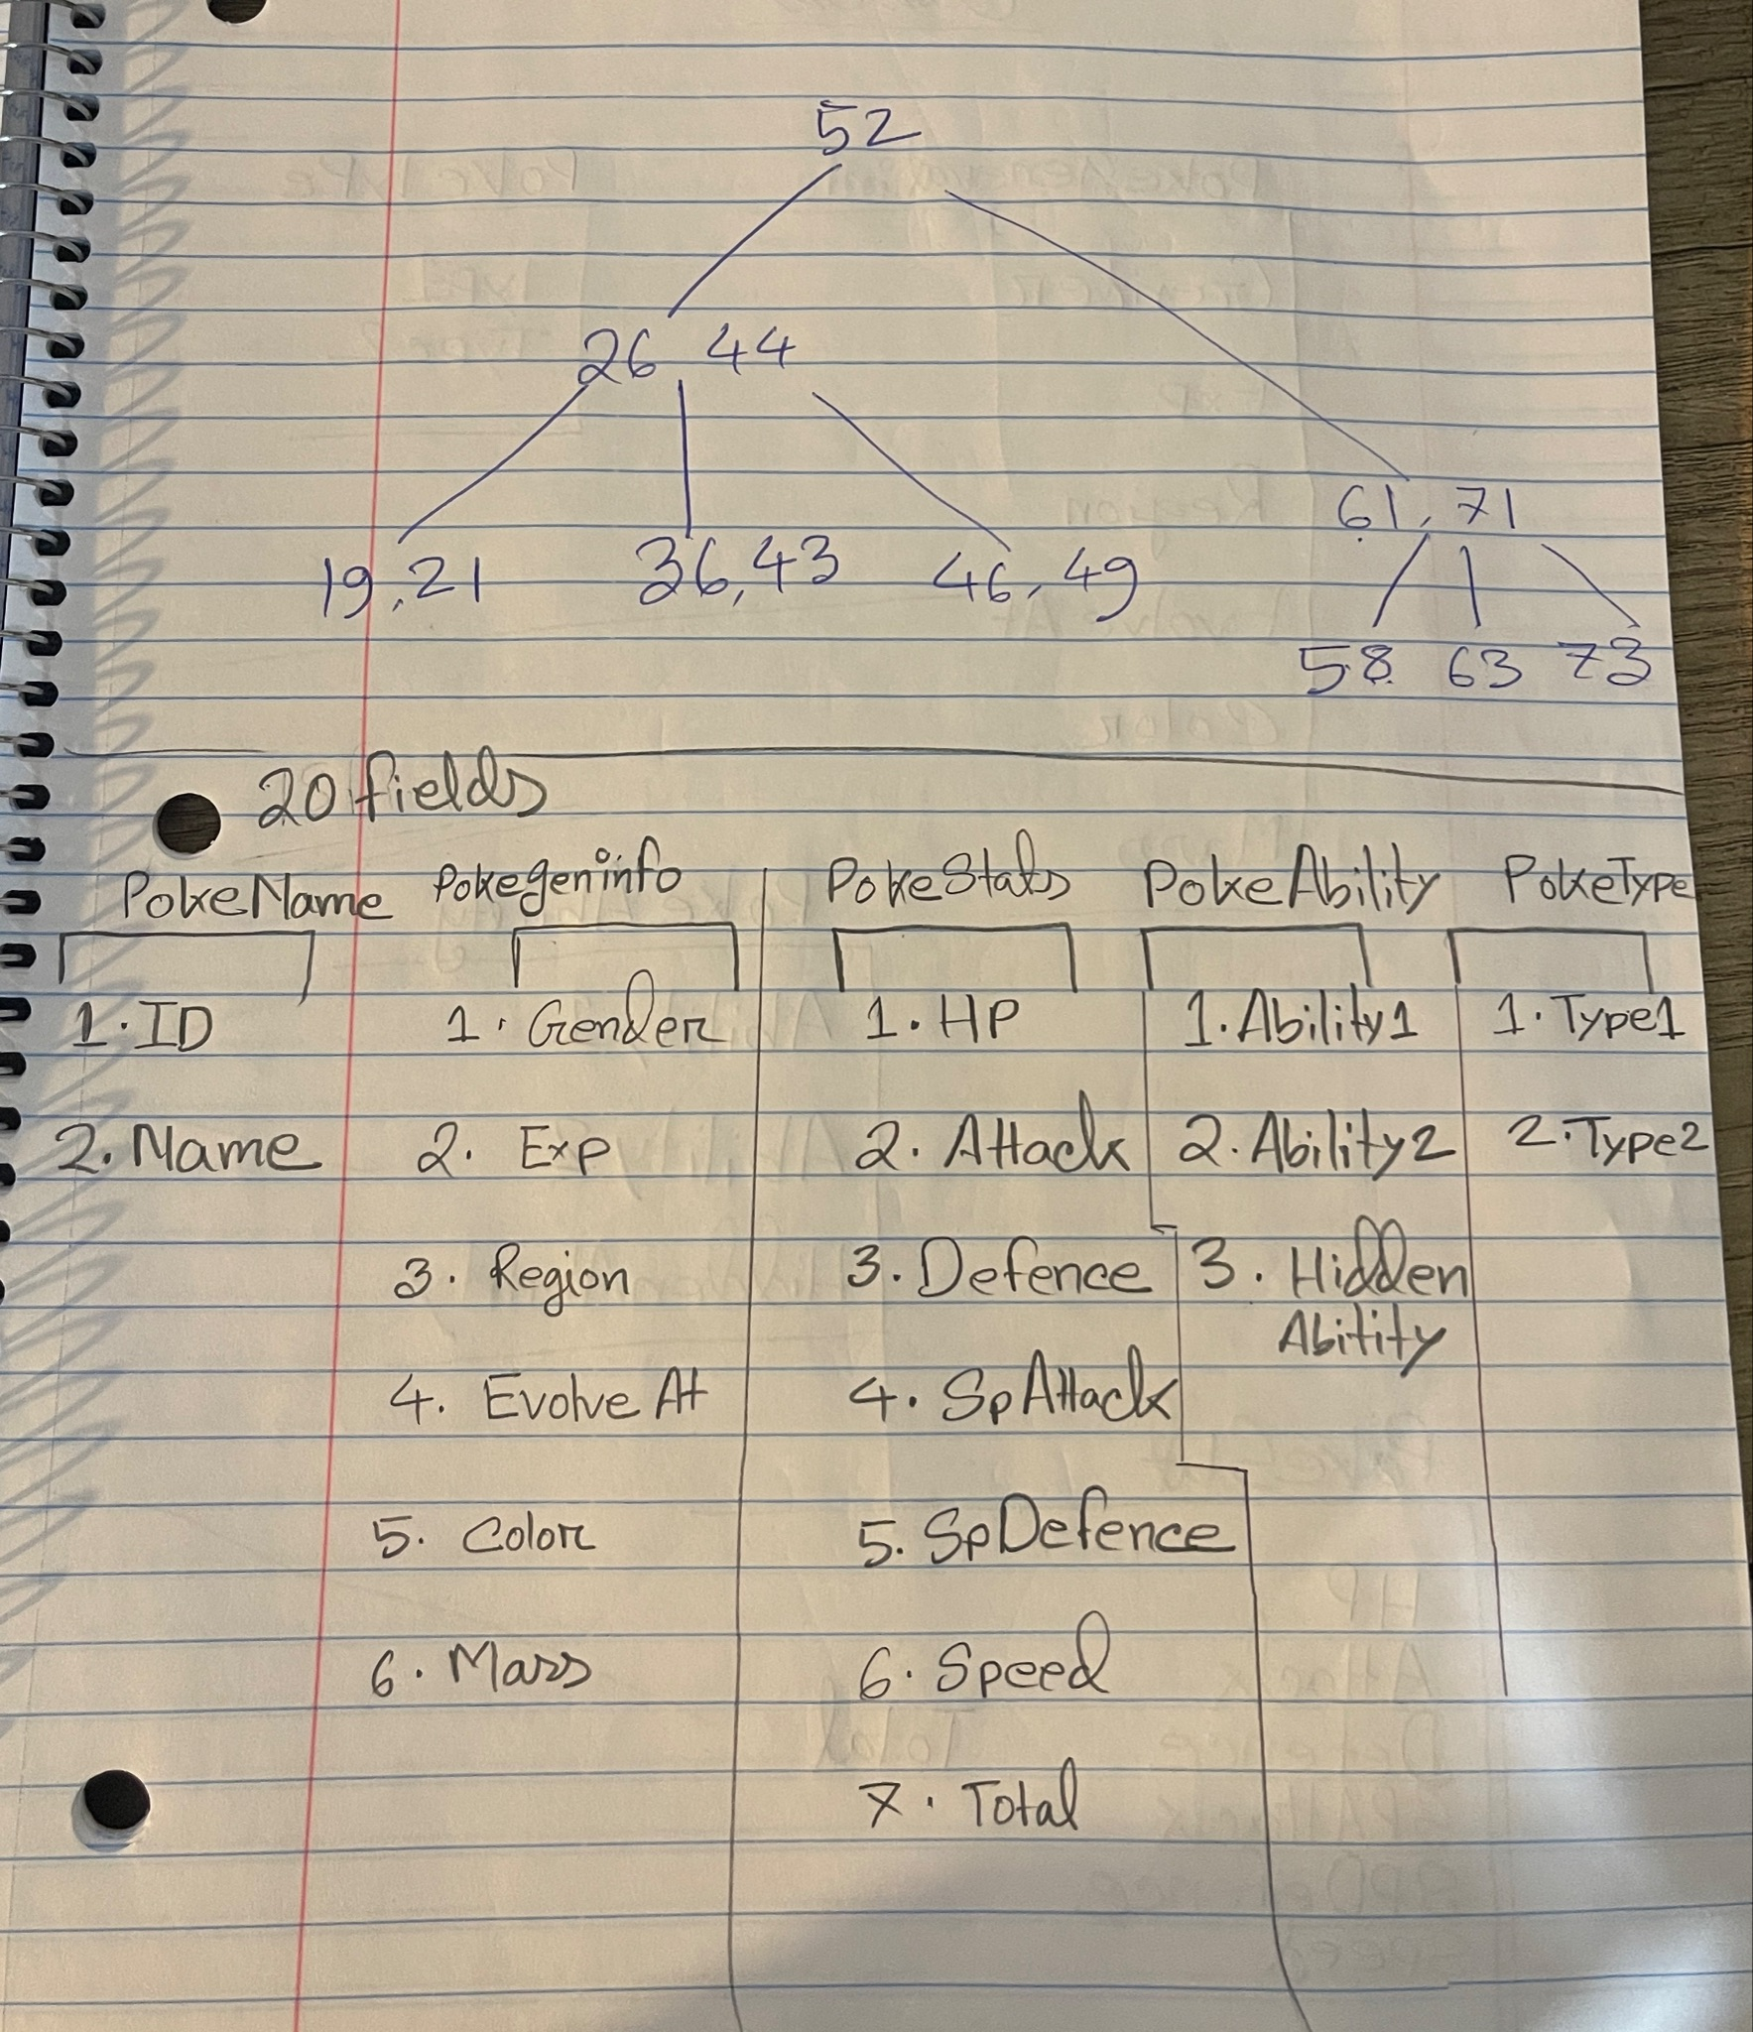
PLANNING

Slide 7
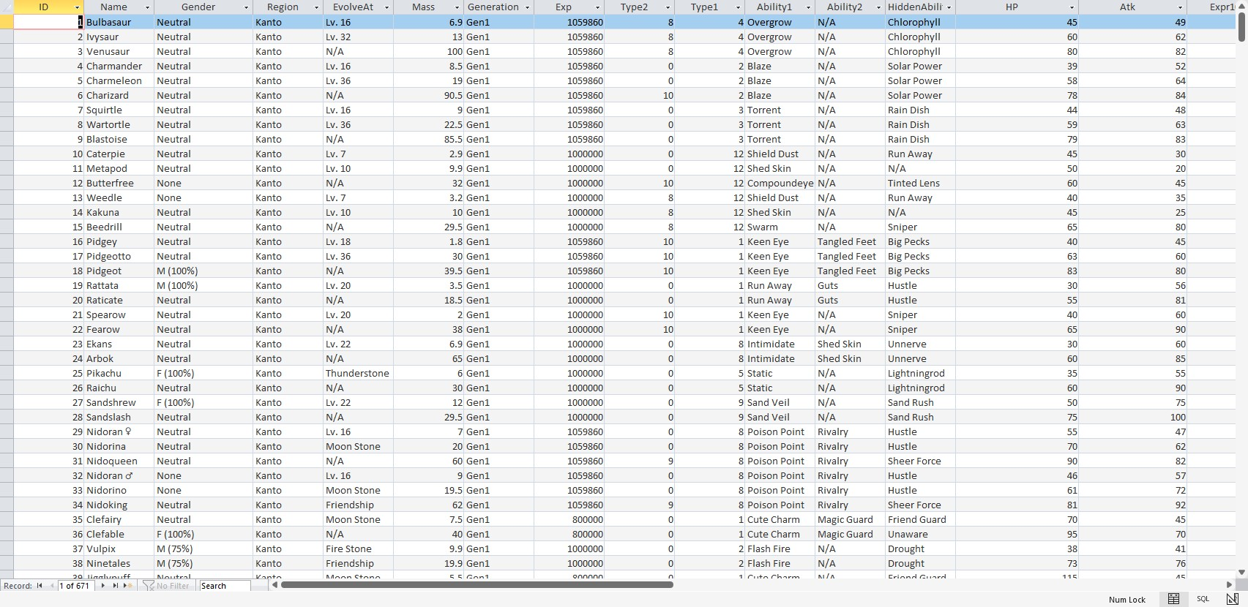
One big table with all data

Slide 8
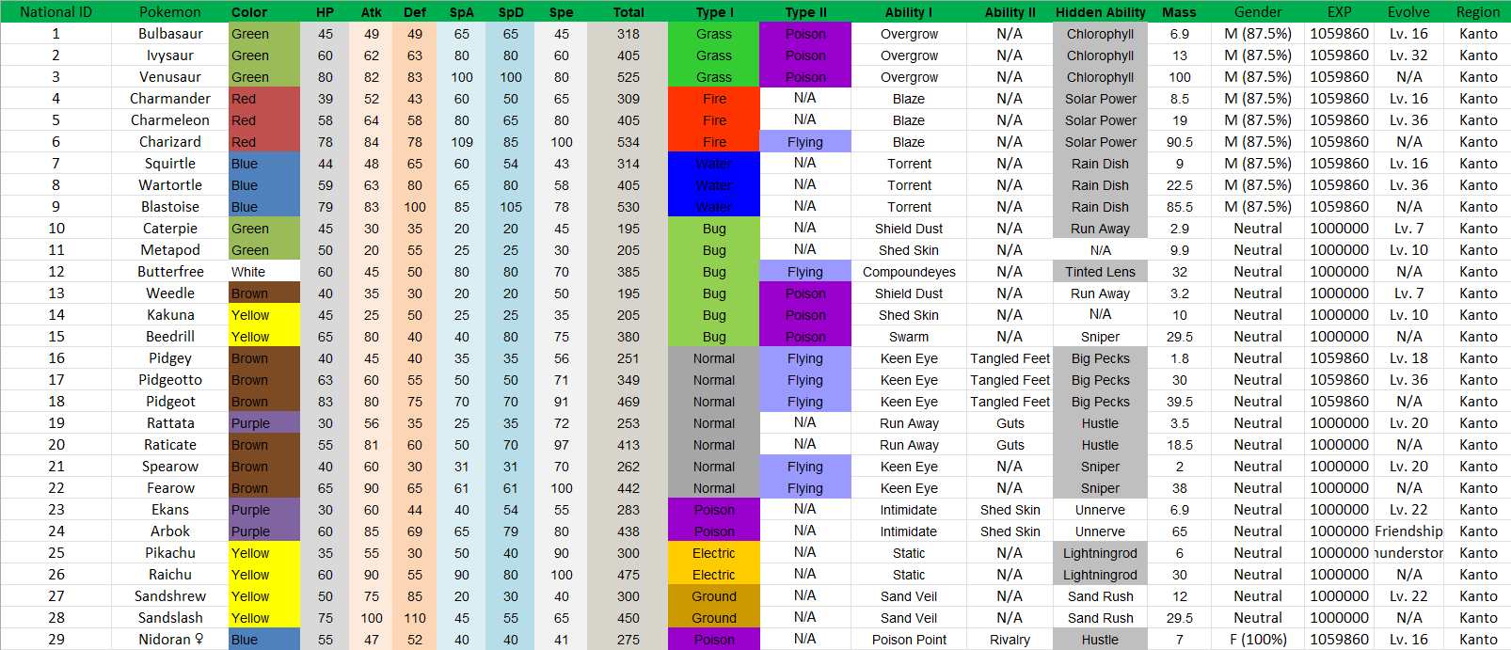
INITIAL DATA SPREADSHEET

Slide 9
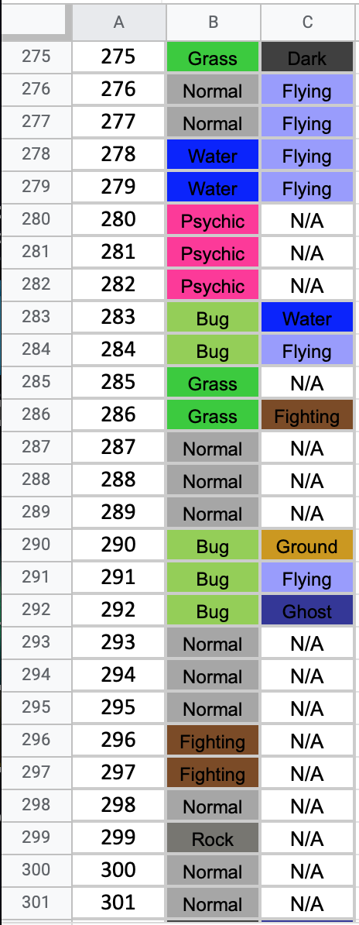
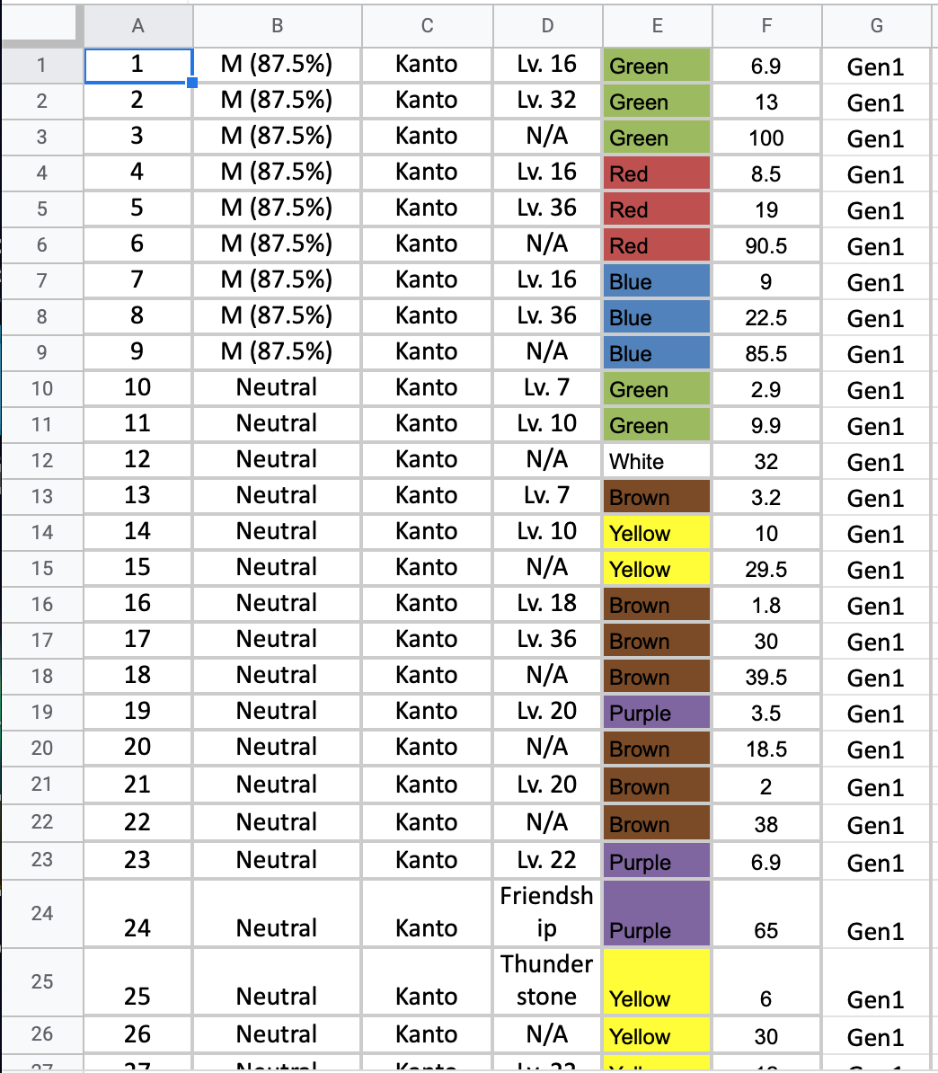
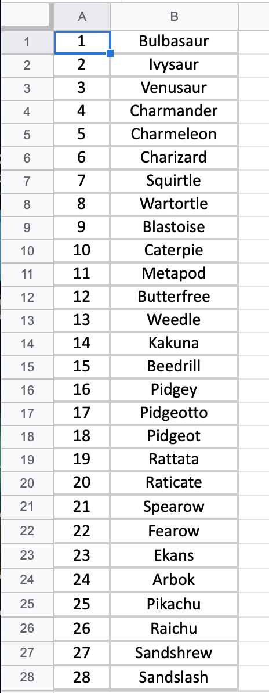
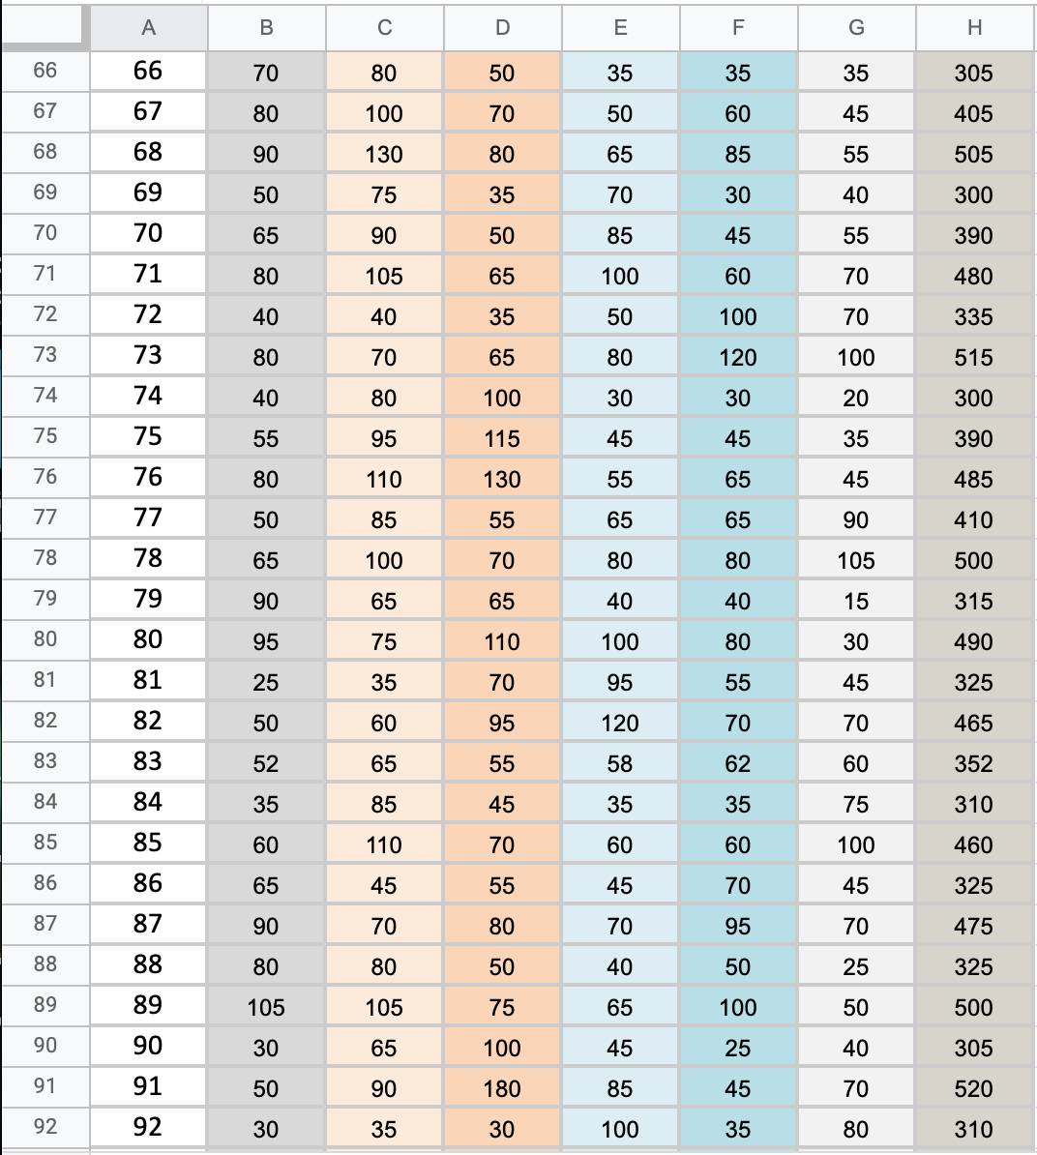
MORE DATA - (but split up)
PokeType
PokeGenInfo
PokeName
PokeStats

Slide 10
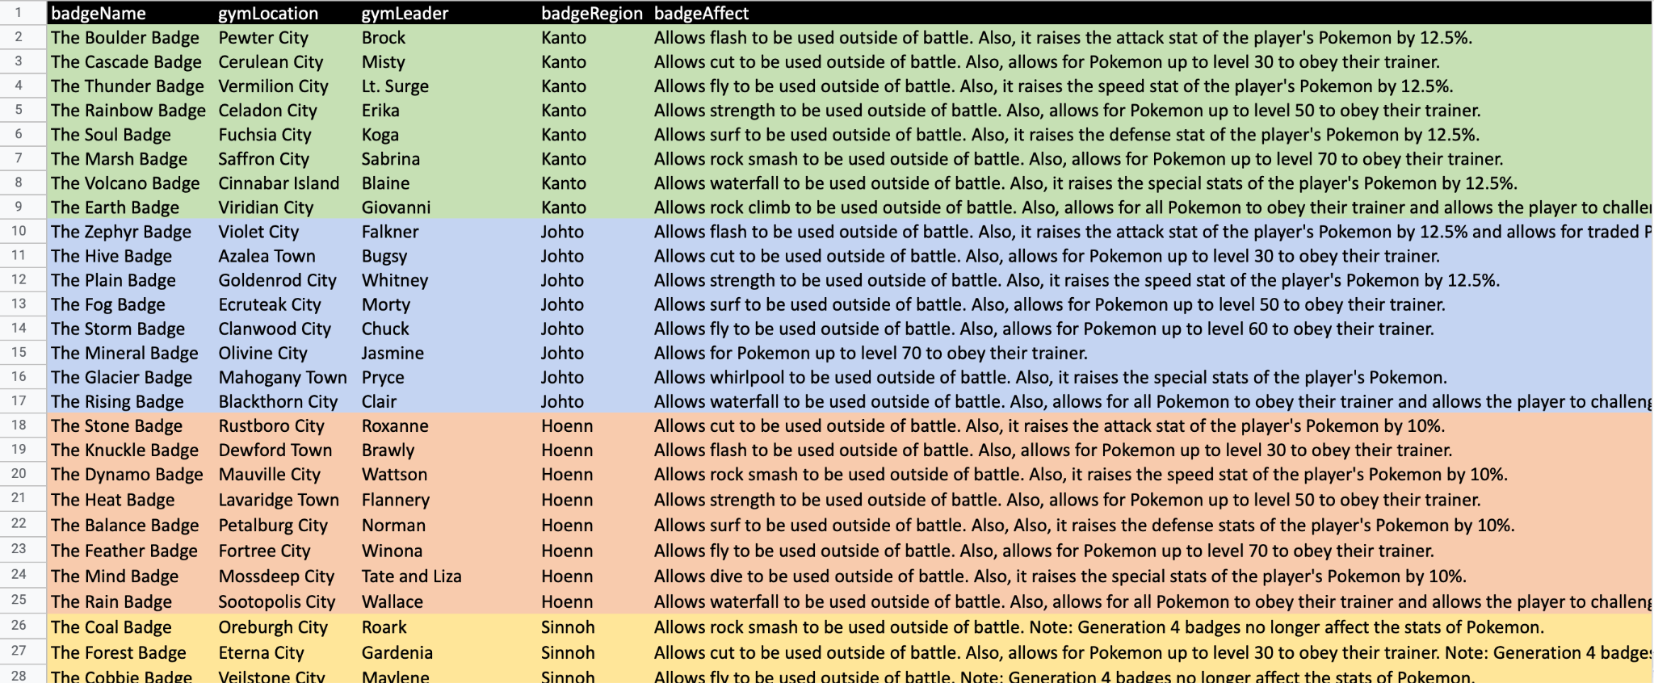
EVEN MORE DATA!!
PokeBadges

Slide 11
Pokémon's Attributes
20 fields related to 1 Pokémon
Bulbasaur

Slide 12
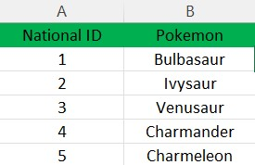
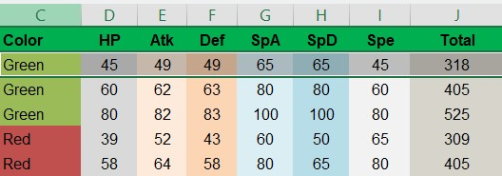
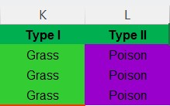
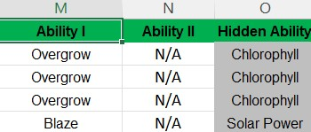
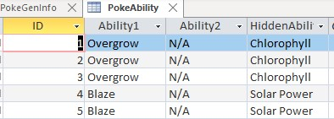
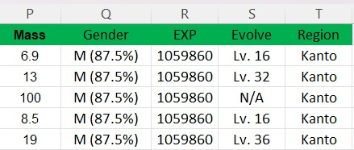
Exporting excel data into individual tables
Pokemon
PokeStat
PokeType
PokeAbility
PokeGenInfo

Slide 13
Whose Attribute??
??
Whose Type??
Whose Stats??
Whose Ability??
Whose Info??

Slide 14
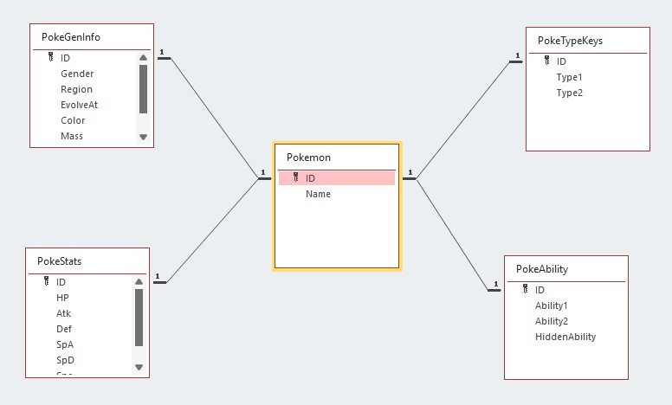
Relationship among tables

Slide 15
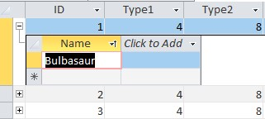
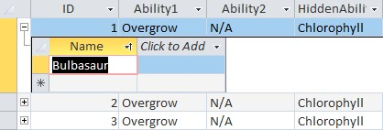
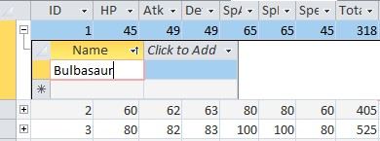
Bulbasaur’s Attribute!!
Bulbasaur’s Type!!
Bulbasaur’s Ability!!
Bulbasaur’s Stat!!
Bulbasaur’s Info!!

Slide 16
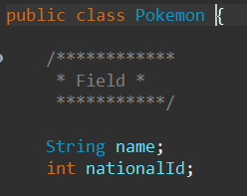
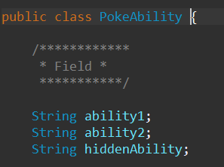
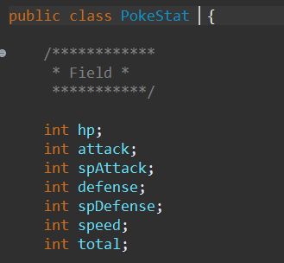
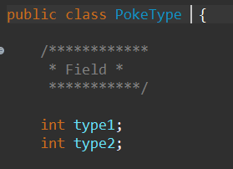
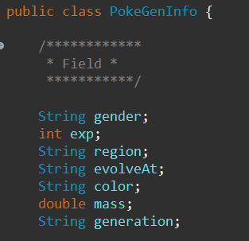
Tables to Classes

Slide 17
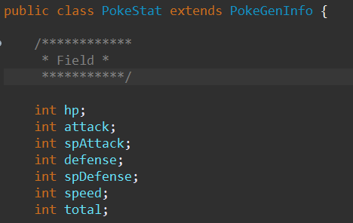
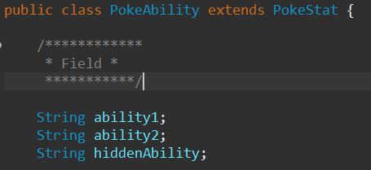
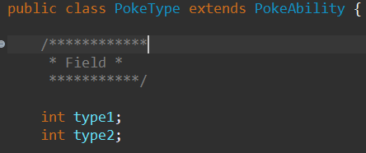
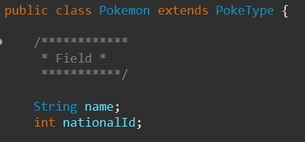
Class Relationship
G/G/G Father
G/G Father
Extends
Grand Father
Father
Child

Slide 19
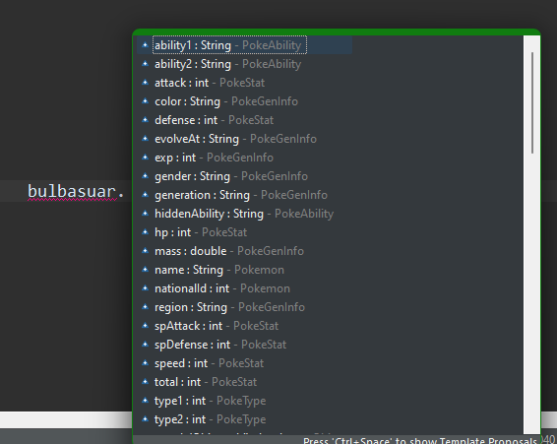

Slide 20
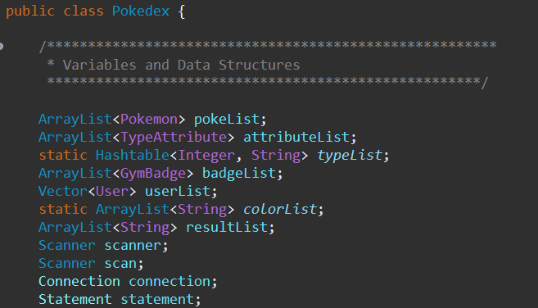

Slide 21
Join Query

Slide 22
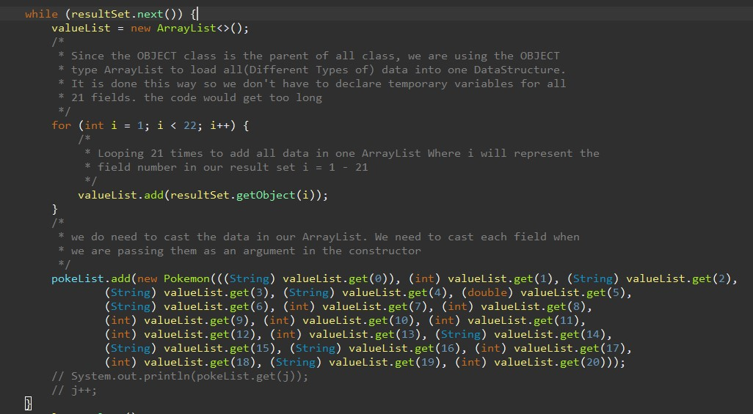
Creating Pokémon object and passing all the corresponding data

Slide 23
Using super keyword to pass data upward

Slide 24
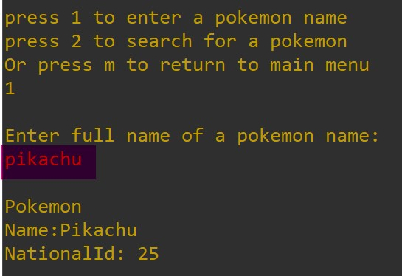
Search by Full Name

Slide 25
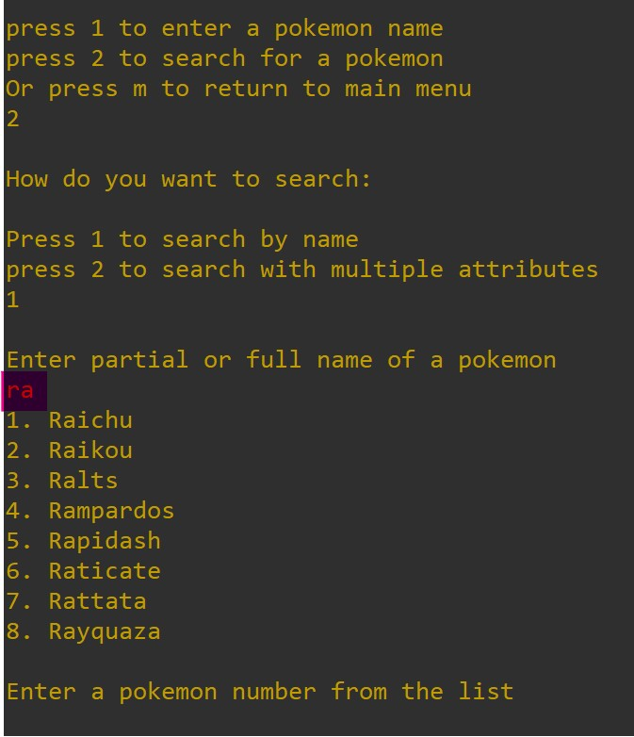
Search Partial or Full Name

Slide 26
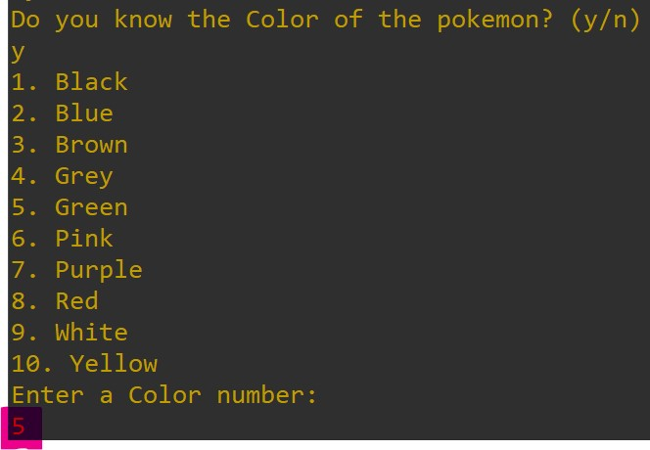
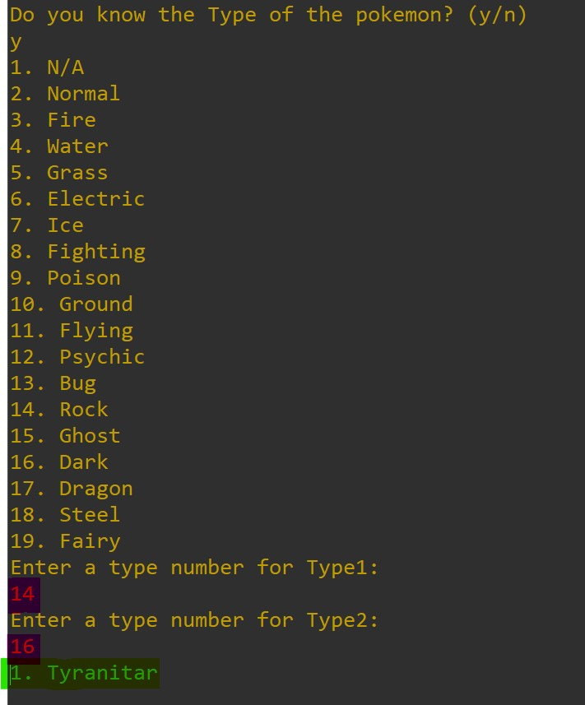
Search by multiple attributes

Slide 27
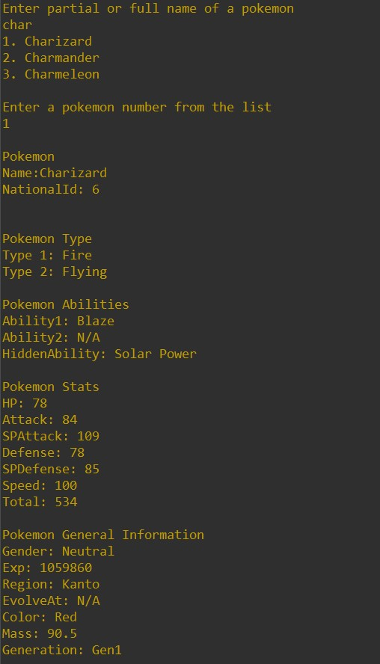
Attribute of one Pokémon

Slide 28
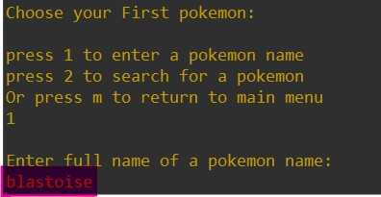
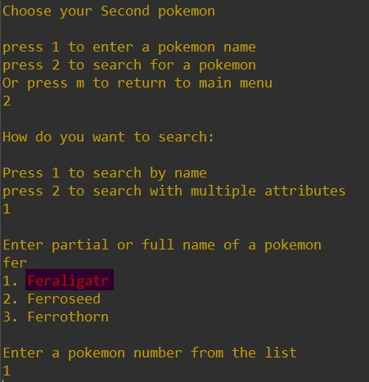
Attributes of two Pokémon

Slide 29
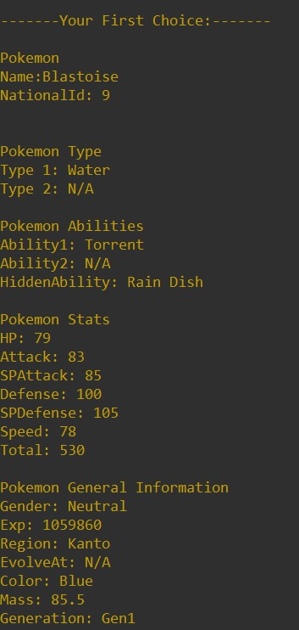
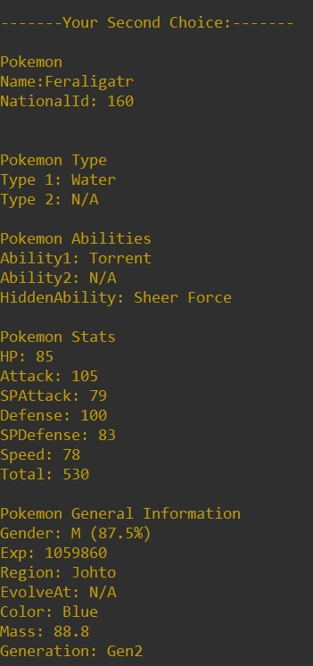
Attribute of two Pokémon

Slide 30
Type Comparison
Strong against
Weak against

Slide 31
Type Comparison

Slide 32
Type Comparison
Superiority
4 6 12 17
3 9 13
Inferiority

Slide 33
Type Comparison

Slide 34
Type Comparison

Slide 35
Compare Pokémon
Winner!!!

Slide 36
Compare Pokémon
Score 1
Score 0

Slide 37
Pokémon Evolution Method

Slide 38
Pokémon Region

Slide 39
Pokémon Region method

Slide 40
View Move Set method

Slide 41
View Badge Info

Slide 43
Pokemon Database

Slide 44
Modify Pokemon

Slide 45
What is the potential of our
system?

Slide 46
Thank you!
Now it’s…
DEMO TIME!

